Slide 1

Travel Data Analysis
CREATED BY
KARISHMA GROVER & SATYAM PATEL

Slide 2
Problem Statement
Since 2008, guests and hosts have used Airbnb to expand on traveling possibilities and present a more unique, personalized way of experiencing the world. This dataset describes Amsterdam's listing activity and metrics in 2022-2023. The data file includes all the information needed to learn more about hosts, geographical availability, and necessary metrics to make predictions and draw conclusions.
Objectives: Research Questions
Who are the top earners
Any particular location getting the maximum number of bookings
Price relation with respect to location
Relationship between Quality and Price
Price vs amenities
Price vs location

Slide 3
Approach
Collecting and understanding the data
Data Cleaning, Data Transformation, Data Modeling
Data Visualization using Power Bi
Understanding Problem Statement

Slide 4
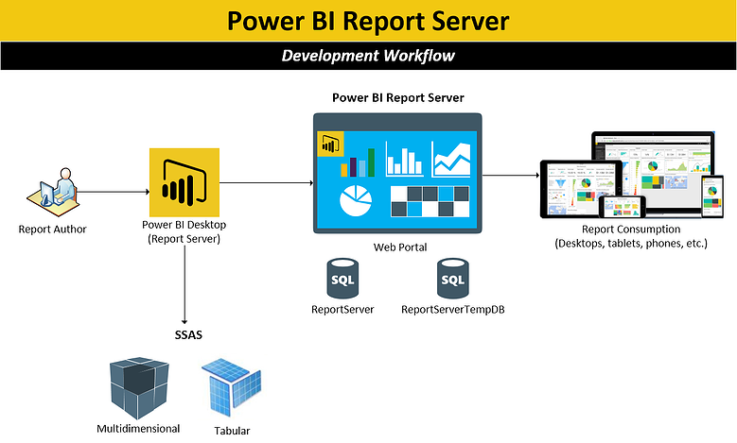

Slide 5
What is the benefit of Airbnb Data Analysis?
Airbnb Data Analysis is basically a data-driven strategy for managing the business. This will help to identify and address issues in your short-term rental plan. If you want to optimize your Airbnb listing to obtain more bookings, you’ll need comprehensive analytics for hosts—from real estate market data to Airbnb rental income. We were able to identify all challenges of the travel industry and how the booking system works. Airbnb analysis will also give insights on Earning, Hosting Progress, Occupancy and rates, Quality, and Conversions.

Slide 6
Which Data We Used It
For this project, we used data that give the listing summary from the city of Amsterdam for the years 2022-2023. Amsterdam is a city always buzzing with travelers. Good food, diverse crown, and vibrant culture make it a favorite travel destination for many. This dataset had a lot of important aspects.
List of items used:
Listing Id, Host Name, Host Id, Location/ Area name, Room Type, Latitude, Longitude, Count of amenities, Price, availability, Date, etc.
Using this information, we have figured most common Areas that were frequently booked or the Percentage of Client visits is higher.

Slide 7
Step Followed :
Collecting the data from the sources.
Performing the Data cleaning with the help of Excel, Python, and Power Query in which we removed irrelevant columns such as Neighborhood Group, name, sirvey_id, city, borough, mainstay, etc.
Performing conditional replacement in currency sign in the price.
Converting Amenities names with the count of Amenities using the Excel Count function.
Converting the data type of price from string to float64 using the .astype(float) command
Checking all duplicate values and replacing them with ‘0’
Finding Booked days by subtracting (365 – the availability of 365) at a particular neighborhood.

Slide 8
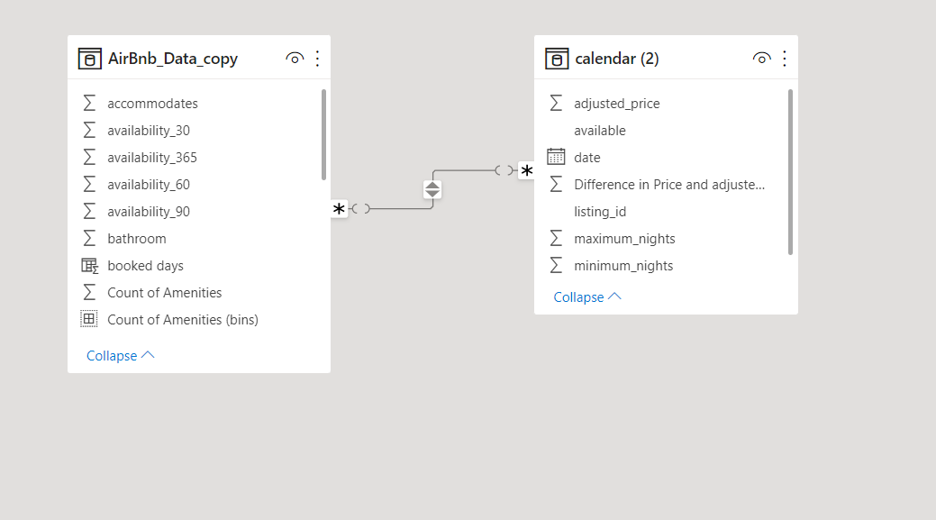
Continue…

Slide 9
Continue…
Created Calculated Bins for moving the by using group option in Power BI
Created Groups for the review score in order to measure them with reviews as Fine, Good, Average, Excellent.
Try to solve the problem statement by using different visuals in power bi.

Slide 10

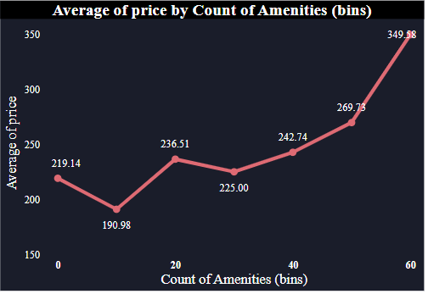
Insights
The price of listings with a higher count of amenities had a significantly higher average price compared to listings with fewer amenities. Specifically, listings with a total of 60 amenities had the highest average price of 349.58, which was 83.04% higher than listings with only 10 amenities, which had the lowest average price of 190.98. Overall, the average price of listings varied between 190.98 to 349.58 across all counts of amenities.

Slide 11
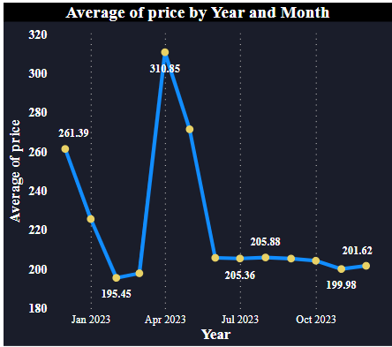
Continue…
The average price of a room type decreased by 11.34% between January and November 2023, with a steep decline of 2.62% in just four months from July 2023. The average price dropped from 205.36 to 199.98 during its steepest decline between July and November 2023.

Slide 12
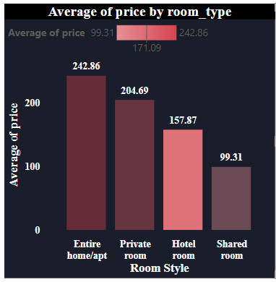
Continue…
The Entire home/apt had the highest average price at 242.86, while the Shared room had the lowest average price at 99.31. Hotel rooms had an average price of 157.87. The average price varied from 99.31 to 242.86 across all four types of rooms, and the order of average prices was Entire home/apt, Private room, Hotel room, and Shared room.

Slide 13
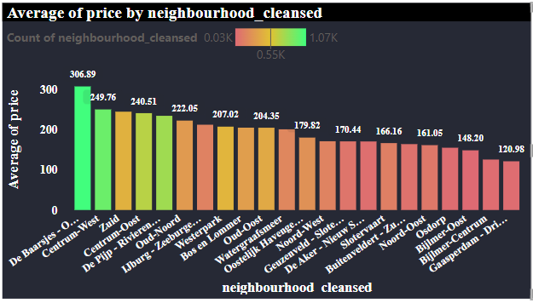
Continue…
The average price of accommodations in De Baarsjes - Oud-West was the highest at 306.89, while Gaasperdam - Driemond had the lowest average price at 120.98. The average price across all 22 neighborhoods ranged from 120.98 to 306.89.

Slide 14
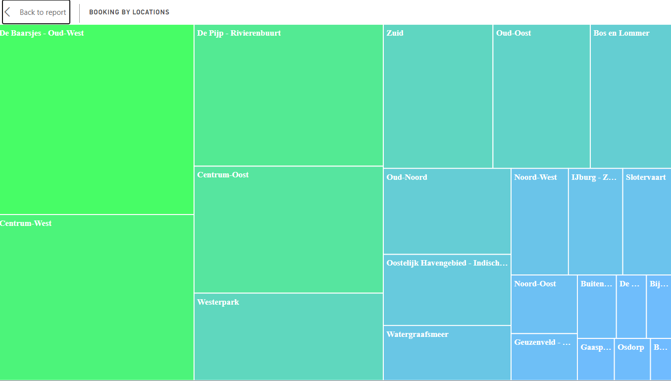
Continue…
The Most location was De Baarsjes

Slide 15
Summary
Listings with more amenities had higher prices, with a significant difference between 60 and 10 amenities. The average price of a room type decreased by 11.34% from January to November 2023, with a sharp decline of 2.62% from July to November 2023. The entire home/apt had the highest average price, and the Shared room had the lowest. De Baarsjes - Oud-West had the highest average price of accommodations, while Gaasperdam - Driemond had the lowest.

Slide 16
Thank you

